Slide 1
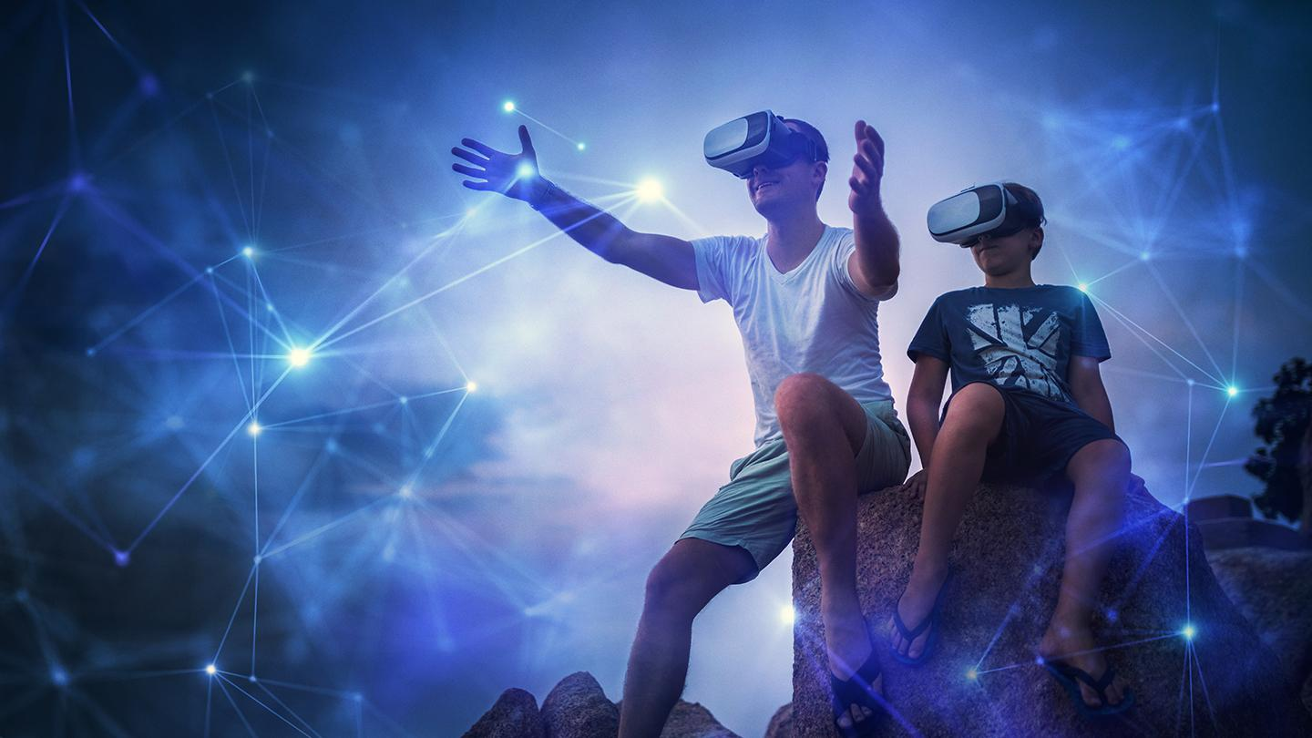
Predicting Avatar Movement in Virtual Reality using Neural Networks
Jakob Fehle, David Halbhuber and Jonathan Sasse
Notes:
Image: https://www.foundry.com/insights/vr-mr-ar/immersive-vr-experiences

Slide 2
Introduction
Temporal deferred movements in virtual reality affect human performance while completing tasks
Neural networks can be used to predict movement of avatars
Utilize prediction mechanisms to evaluate the neural network model providing the most significant positive effect on performance
- 12ms
0ms
12ms
24ms
36ms
48ms

Slide 3
Method
Using our system of predicting body movements we conduct a study where the game performance is evaluated
Full body movement based game developed with Unity
Player is getting attacked by wasps
Play-area is a cage
Number of incoming wasps increases exponentially
Wasps engage from 4 varying spawn points (defined sequence)
Objective is to kill incoming wasps by using hands
Wasp fades when killed or when its attack was successful (reached players avatar)
Game ends after competing 100 wasps

Slide 4
Method
Within-subjects study design
Independent variables:
Temporal Adjustment (-12ms, 0ms , 12ms, 24ms, 36ms, 48ms)
Dependent variables:
Kills
Wasp lifetime
Questionnaires: IPQ + Limb Ownership

Slide 5
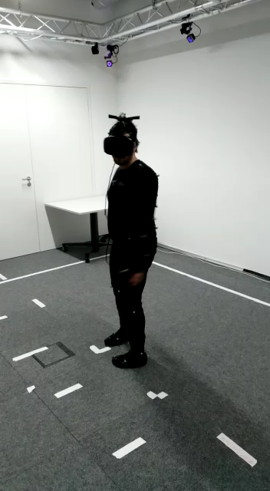
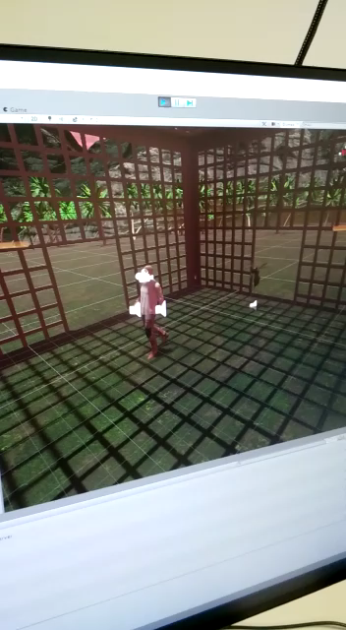
Game

Slide 6
Results

